Slide 1
Introduction to the RHC
Drone Industry Action Group
13 October 2020

Slide 2
Notes:
The RHC is a brand-new independent expert committee made up of a Chair and 5 Council members with cross-cutting expertise supported by a team of civil servants.
Report to the BEIS SOS with recommendations.
What is the problem we’re trying to solve?
The Fourth Industrial Revolution is creating a wave of technological change ​
It poses challenges for traditional regulatory systems, which can struggle to keep up with new products and services ​
We need to make our regulatory system more agile and seize the opportunities ahead​
The Council has a critical role in enabling the UK to maximise the value from technological innovation - across social, environmental, and economic domains​
The Council will assist in ensuring this is done in a way that maintains public trust ​
RHC objective:
To identify the implications of technological innovation and advise government on regulatory reform needed to support its rapid and safe introduction. Recommendations may include introduction, adaptation or repeal of regulation, or the adoption of alternatives (i.e. voluntary standards, education).
Anticipatory regulation:
We take an anticipatory approach to regulation which is future-facing so that regulation is resilient to uncertainty in fast-changing markets. This also includes a focus on outcomes-based regulation where well-defined goals are set rather than rules.

Slide 3
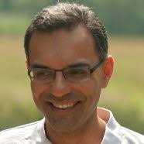
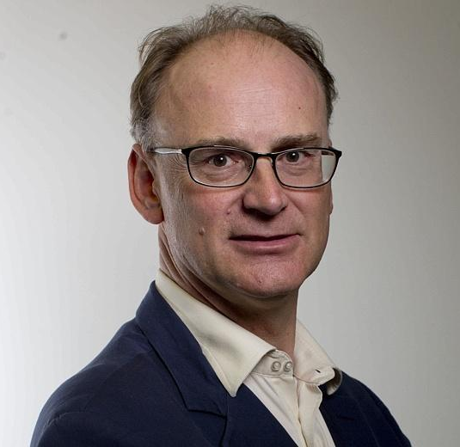
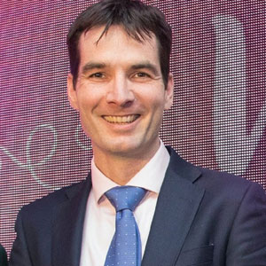
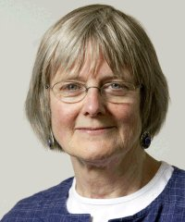
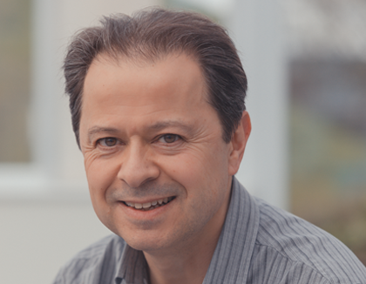
Council members
Cathryn Ross, Chair
Director, Regulatory Affairs Group, BT
Experience as Chief Exec Ofwat, extensive work in other regulators
Dr Parag Vyas
Director, PV10 consult (technology consulting)
Chartered Engineer
25 years experience in energy and transport industry sectors
Matt Ridley
Self-employed writer and businessman, previously science editor at The Economist
Sits in the House of Lords, serves on Science and Technology committee
Professor Alastair Denniston
Consultant Ophthalmologist
AI Theme Lead at Uni of Birmingham Centre for Regulatory Science and Innovation
Professor Joyce Tait
Co-Director, Innogen Institute
Professor, University of Edinburgh
Specialises in governance-stakeholder interactions in life sciences
Dr Andy Greenfield
Programme Leader, Medical Research Council Harwell Institute
Previous board member Human Fertilisation & Embryology Authority
Expertise on ethical innovation and policy
Notes:
https://www.gov.uk/government/groups/regulatory-horizons-council-rhc#membership

Slide 4
RHC priority areas for next 6 months
1) Gene-based technologies;
2) Nuclear fusion;
3) Unmanned Aircraft (including Drones); and
4) Diagnostic medical devices.
Notes:
Lisa

Slide 5
RHC participatory approach
We aim to work in an agile and disruptive way, advocating cases for change and turning engagement into regular and iterative products.
Recommendations are very much envisioned as being developed in a participatory way by regularly sharing early versions of products with stakeholders for iteration.
We will actively engage using roundtables, workshops, interviews and events with innovators, venture capitalists, industry, academia, civil society, regulators and government to share knowledge, collaborate and inform our work, ensuring we are accounting for a broad range of perspective.
Help us to help you – get in touch!
Notes:
Lisa

Slide 6
Potential exam questions - unmanned Aircraft (including Drones)
Vision. To examine how to optimise aviation regulation for unmanned aircraft (including drones) to enable and shape the development of innovations over a c. ten-year time horizon. To consider preferred futures for aviation products and services. [What’s the future vision?]
Licencing. To work with the CAA to review and reframe their regulatory process, identifying where there may be opportunities to shift from a manual process that requires a series of human interventions for every application, to working with and supporting the businesses providing drone services and developing automated approvals for core activities, saving their manual function for the trickier examples. [How do we increase the number of approvals?]
BVLOS. For BVLOS applications, to work with the CAA and industry to develop (a) the technology and systems that are acceptable under the existing regulations and/or (b) the industry & regulatory standards to support the proliferation of good practice and recognised approaches, thereby increasing the clearance rate and numbers.
Spectrum. To explore potential to reform regulation of the use of radio spectrum – 4/5G specifically (?) - for the purposes of communicating with unmanned aircraft in commercial operations. [Contention: regulatory constraint on commercial activity.]
Data. Is the regulation of the data collected by unmanned aircraft future-proof? Is there potential for reform of data policy – via a data strategy or perhaps a national data centre for unmanned aircraft - to provide an advantage to UK PLC? Would this require regulatory reform and if so, what? [Contention: In the UK, drone data collection is associated with high costs]
Airspace management. Can the regulation of airspace be reformed to enable more innovation?
Notes:
[Not seeking to get into the substance]

Slide 7
Next steps
Feedback from DIAG on potential exam questions - either individually or collectively
RHC to finalise exam question on unmanned aircraft
RHC will invite willing participants to future workshops
Email: lisa.day@beis.gov.uk and tris.bishop@beis.gov.uk
Twitter: @RHC_UK
Newsletter: email us at regulatoryhorizonscouncil@beis.gov.uk
Notes:
Tris

